Slide 1

Module 2
Master of Computer Applications
23MCAG205– FUNDAMETNALS OF DATA SCIENCE
Simple Metrics and Visualization

Slide 2

Module No. 2
Syllabus
Simple Metrics and Visualization
Descriptive Statistics–Mean, Standard Deviation, Skewness and Kurtosis,
Introduction to Visualization, Role of Visualization,
Type of Datasets in Analytical Problems,
Effectiveness of Visualization across Data Types,
Visualization Tools—Pie Charts, Bar Diagrams, Histograms, Boxplots, Scatterplots, Heat-maps.

Slide 3
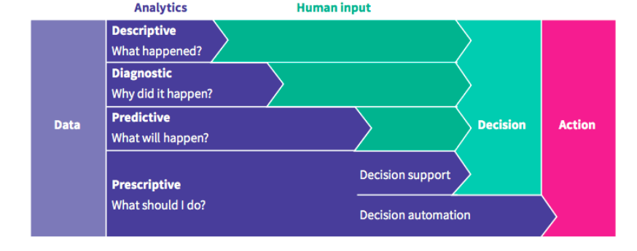
Module No. 2
Analytics & types
Analytics is the systematic computational analysis of data or statistics.
It is used for the discovery, interpretation, and communication of meaningful patterns in data.
It also requires applying data patterns toward effective decision-making
Notes:
Image source: https://datajourney.akvo.org/blog/the-four-types-of-data-analysis?utm_term=statistical%20analytics&utm_campaign=&utm_source=adwords&utm_medium=ppc&hsa_acc=7028243667&hsa_cam=2077694068&hsa_grp=133193406680&hsa_ad=566786827399&hsa_src=g&hsa_tgt=kwd-296901621574&hsa_kw=statistical%20analytics&hsa_mt=b&hsa_net=adwords&hsa_ver=3&gclid=Cj0KCQjw5f2lBhCkARIsAHeTvlglRtN6KJGgzh0MVVu7VhpFfRjFrMpcIVU5UWaMoh-qWnOlVp6-PFIaAmYpEALw_wcB&utm_term=statistical%20analytics&utm_campaign=DataJourney-+Blog&utm_source=adwords&utm_medium=ppc&hsa_acc=7028243667&hsa_cam=2077694068&hsa_grp=133193406680&hsa_ad=566786827399&hsa_src=g&hsa_tgt=kwd-296901621574&hsa_kw=statistical%20analytics&hsa_mt=b&hsa_net=adwords&hsa_ver=3

Slide 4
Module No.2
Statistics
It is the study of
- collected numeric data to provide meaningful information with it.
- collects, analyses, interprets, and presents data in the best possible way to extract pieces of information through it.
Statistics:
- focus on making predictions about what will happen in the future.
- It can also focus on explaining how different things are connected.
- gives us more accurate knowledge which helps us make better decisions.
Steps of Statistical Methods
Gathering data
Describing and visualizing data
Making conclusions

Slide 5
Module No. 2
Descriptive Statistics
It refers to a set of methods used to
summarize and describe the main features of a dataset, such as its
central tendency (Mean, Median, Mode),
variability (lack of consistency), and
distribution.
Getting a quick overview of how the data is distributed is an important step in statistical methods.
Calculate key numerical values about the data that tells the about the distribution of the data.
Draw graphs showing visually how the data is distributed

Slide 6




Module No. 2
Mean or Arithmetic Mean
Arithmetic Mean is the average of all data values which you work with.
Mean is used to find the average value around which your data values range.
Helps produce a term that has minimum error out of all terms in the data set.
Helps to minimize the individual error occurring at any data point.
Example:

Slide 7
Module No. 2
Standard Deviation
It is a technical term for a measure of inconsistency.
It refers to the amount of variability or dispersion (distribution) around an average in statistics.
Variance - difference between the actual and average value is known as dispersion or variance.
The standard deviation increases as the dispersion or variance increases.
A number that represents how one group differs from the mean value of entire group or data set.
One of the most popular Use Cases for Standard Deviation is in Finance.
Ex: A stock with a mean price of $35 and a standard deviation of $5,
- means that the price majority of the time will be between $30 and $40.

Slide 8
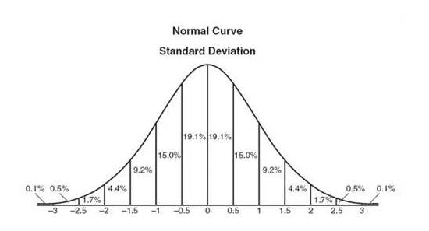
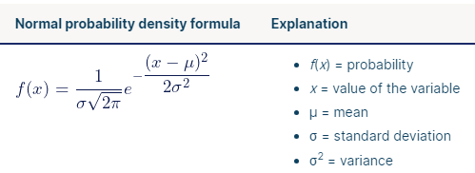
Module No. 2
Normal Distribution
Data that is Normally Distributed
This tell us most values are near the mean
When data is normally distributed this means the Mean and Median are equal
When data is not normally distributed that means a bias to the left or right exists
Represented by a Standard Bell Curve
Symmetrical Distribution
What is the shape of a data distribution?
A distribution of data item values may be symmetrical or asymmetrical.
symmetry - ‘Normal distribution’ and
asymmetry - ‘Skewed distribution’

Slide 9
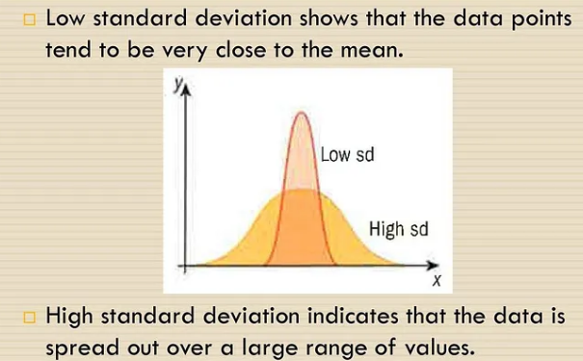
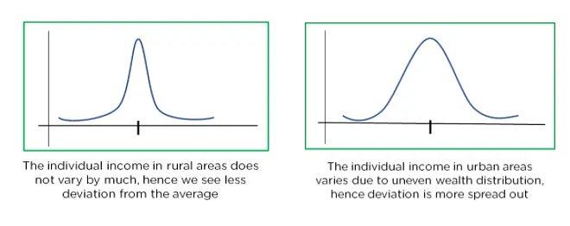
Module No. 2
Standard Deviation
Example: Income in rural and urban areas.
Notes:
Image source: https://cryptoshare.medium.com/what-is-standard-deviation-compared-to-beta-score-and-how-is-it-used-in-stock-market-simply-1e93db685fae

Slide 10

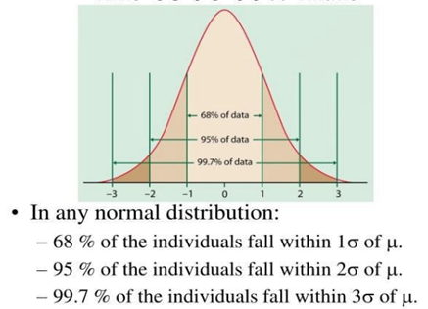
Module No. 2

Slide 11
Module No. 2
Standard Deviation
Example: IQ scores (If Mean = 100, Standard Deviation = 15)
1 Standard Deviation = 85 and 115 = 68% (score falls within 68% of data)
2 Standard Deviations = 70–85 and 115–130 = 95% (score falls within 95% of data)
3 Standard Deviations = 55–70 and 130–145 = 99.7% (score falls within 99.7% of data)
Someone scored = 131
This means 131 is 3 Standard Deviations from our mean which means this person has a score that is 99.7% better than the other scores.

Slide 12
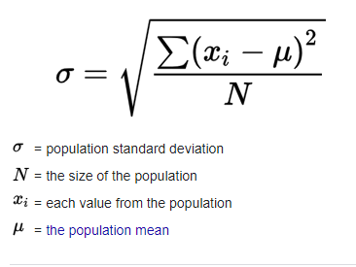
Module No. 2
How to compute Standard Deviation
Formula
Step 1: Compute ‘Mean’ of the given data values.
Step 2: Compute Variance
- Calculate it by subtracting each data point from the mean value and
- then finding the squared mean of the differenced values
Step 3: Find the square root of the variance which gives the standard deviation

Slide 13
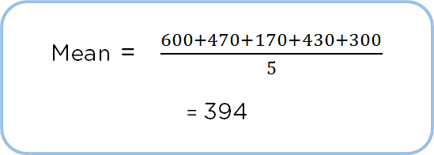
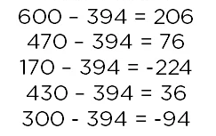



Module No. 2
Example:
Dog Heights:
Step 1: Compute ‘Mean’ or ‘Average’
Step 2: Find the different between exact data and mean
Step 3: Compute the ‘Variance’ =
Step 4: Compute the ‘Standard Deviation’

Slide 14
Module No. 2
Introduction to Visualization

Slide 15
Module No. 2
Introduction to Visualization
A rule of thumb for data science deliverables is this:
- if there isn’t a picture, then Data Scientist doing it wrong.
Typically, a good analytics project starts (after data cleaning and understanding) with
- exploratory visualizations that helps to develop hypotheses and
- get a feel for the data, and it ends with carefully shaped figures that make the final results visually clear.
There are a no. of projects where there is never even any actual machine learning:
- people need to know whether there is a signal in the data and
- which directions is most promising for further work, etc. and
- graphics show that more clearly than a number ever could.

Slide 16
Module No. 2
Data Visualization
It is defined as a graphical representation that contains the information and the data.
It is one of the most important skills and the process of creating interactive visuals to understand trends, variations, and derive meaningful insights from the data.
It is used mainly for
- data checking and cleaning,
- exploration and discovery, and
- communicating results to business stakeholders.
Helps to
- explore the dataset and
- extract some information to know about a dataset and
- identifying patterns, corrupt data, outliers, and much more.
provides an important suite of tools for identifying a qualitative understanding.

Slide 17
Module No. 2
Used to express and identify key relationships in plots and charts that are more helpful to Data Analytics/Scientist and stakeholders
Visual elements like charts, graphs, and maps, data visualization techniques provide
- an accessible way to see and understand trends, outliers, and patterns in data.
It is used in many areas such as:
-To model complex events.
-such as weather patterns, medical conditions, or mathematical relationships.

Slide 18
Module No. 2
Role of Data Visualization
1. Data Checking and Cleaning:
Data visualization can be used to look for noticeable errors in the dataset including
- Nulls,
- Random values,
- Distinct records,
- the format of Dates,
- Sensibility of spatial data, and
- String and Character encoding.

Slide 19
Module No. 2
Role of Data Visualization
2. Data Distribution:
Data visualization can be used to understand the distribution of the data,
- look for central tendencies (mean, median, and mode),
- understand the presence of outliers using a boxplot, check for skewness, and
- ever understand the impact of winsorization on data distribution.
Winsorization - the transformation of statistics by limiting extreme values in the statistical data to reduce the effect of possibly fake outliers.

Slide 20
Module No. 2
3. Model Assumptions:
Linear regression and other classification models follow certain underlying assumptions like
- data has to be normally distributed,
- the correlation between different independent variables shouldn’t exist,
- homoscedasticity/homogeneity of variance of error terms, and many more.
Hence visualizations are a key to validating some of these assumptions as well.
Homoscedasticity describes a situation in
- which the error is the same across all values of the independent variables.

Slide 21
Module No. 2
4. Human-in-the-Loop Analytics:
Data scientists often use humans in the loop analytics to
- get a look and feel of the data,
- make a hypothesis,
- run appropriate analytics to validate the hypothesis, and
- repeat the process till conclusive evidence is determined.

Slide 22
Module No. 2
5. Dimension Reduction:
While working with multiple variables it is difficult to visualize the data in an n-dimension space.
Ex:
A data set that has different customer attributes (say numerical) it is difficult to plot the customers considering all attributes.
In scenarios like this, dimension reduction techniques like Principal Component Analysis (PCA) can be useful to bring down the attributes to fewer dimensions.
PCA finds linear combinations of variables that best explain the observations
Factor analysis finds linear combinations of variables that best explain the relationship between the variables.
The reduced dimension can then be plotted to analyze the customers in a 2D space.

Slide 23
Module No. 2
Principal Component Analysis:
- It is a dimensionality reduction method
- it is often used to reduce the dimensionality of large data sets,
- by transforming a large set of variables into a smaller one that still contains most of the information in the large set
Factor Analysis:
- It is a data reduction method
- it reduces a set of variables by extracting all their commonalities into a smaller number of factors.

Slide 24
Module No. 2
Effectiveness of Visualization across Data Types
Different data types:
  Categorical Data type
  Numerical Data Type
I. Categorical Data Type:
- refers to a form of information that can be stored and identified based on their names or labels.
- a type of qualitative data that can be grouped into categories instead of being measured numerically.
Some examples of this data type:
Birthdate
Favorite sport
Hair Color
Height

Slide 25
Module No. 2
Effectiveness of Visualization across Data Types
Types of categorical data
Categorical data often includes values and observations that can be categorized or grouped.
2 kinds of categorical data:
- Nominal Data
- Ordinal Data
1. Nominal Data:
- qualitative data used to name or label variables without providing numeric values.
- is the most straightforward type of measurement scale
- Nominal variables are labeled into categories that do not overlap.
- cannot be ordered
- it does not have equal spacing between values or a true zero value.

Slide 26
Module No. 2
Nominal Data:
Examples:
1. Which state do you live in? (Followed by a drop-down list of names of states)
2. Preferred mode of Public Transport (bus, tram, train)
3. Hair Color (black, brown, grey, blonde)
4. Employment Status (employed, unemployed, retired)
Characteristics of nominal data are:
Nominal data are categorical, the categories being mutually exclusive without any overlap.
Nominal data can never be quantified - The categories of nominal data are purely descriptive, that is, they do not possess any quantitative or numeric value.
Nominal data cannot be put into any definite order or hierarchy.
The mean of nominal data cannot be calculated even if the data is arranged in alphabetical order.
The mode is the only measure of central tendency for nominal data.
In most cases, nominal data is alphabetical.

Slide 27
Module No. 2
2. Ordinal Data
- a kind of qualitative data that groups variables into ordered categories, which have a natural order or rank based on some hierarchal scale, like from high to low.
- often used in surveys, questionnaires, and the fields of finance and economics.
Examples: used in observe customer feedback, satisfaction, economic status, education level, etc.
1. Rank economic status according non-equally distributed to Income level range:
Poor or Low Income ($10K-$20K), Middle income ($20K-$35K), Wealthy ($35K-$100K)
2. Rate education level according to:
Elementary, High School, College, Graduate, Post-graduate
3. An organization asks employees to rate how happy they are with their manager and peers according to the following scale:
Extremely Happy – 1, Happy – 2, Neutral – 3, Unhappy – 4, Extremely Unhappy – 5

Slide 28
Module No. 2
Ordinal Data Characteristics
Ordinal data are non-numeric or categorical but may use numerical figures as categorizing labels.
Ordinal data are always ranked in some natural order or hierarchy.
Ordinal data is always ordered, but the values are not evenly distributed.
Ordinal data can be used to calculate summary statistics,
Ex: frequency distribution, median, and mode, range of variables.
Ordinal data has a median.

Slide 29
Module No. 2
II. Numerical Data
- refers to the data that is in the form of numbers, and not in any language or descriptive form.
2 forms of numerical data : Discrete Data, Continuous Data
1. Discrete data
- used to represent countable items.
- can take both numerical and categorical forms and groups them into a list.
- This list can be finite or infinite too.
- Discrete data basically takes countable numbers like 1, 2, 3, 4, 5, and so on.
Ex:
Finite Countable - counting sugar cubes from a jar is finite countable.
Infinite Countable - But counting sugar cubes from all over the world.

Slide 30
Module No. 2
2. Continuous data
- has data in the form of intervals.
- represents measurements and their intervals fall on a number line
Example: in a school exam, students who scored
81%-100% come under distinction,
60%-80% have first class and
below 60% are second class.
2 types:
a) Interval data - data that can be measured only along a scale at equal distance from each other. - It may not have ‘zero point’ value.
Ex: Measuring Body Temperature using Celsius and Fahrenheit
b) Ratio: has zero point.
Ex: The body temperature, the zero point temperature can be measured in Kelvin.

Slide 31
Module No. 2
Different Types of Analysis for Data Visualization
Mainly, there are three different types of analysis for Data Visualization:
1. Univariate Analysis:
the simplest form of analyzing data. “Uni” means “one”, so in other words your data has only one variable.
means using a single feature to analyze
It doesn’t deal with causes or relationships
it’s major purpose is to describe.
- It takes data, summarizes that data and finds patterns in the data.
Example:
- the analysis might look at a variable of “CGPA” or “No. of Backlogs”.
Visualization Techniques:
Pie Charts, Bar Charts, Histograms

Slide 32
Module No. 2
2. Bivariate Analysis:
- is about studying two variables.
When we compare the data between exactly 2 features then it is known as bivariate analysis.
used to find out if there is a relationship between two sets of values.
It usually involves the variables X and Y.
X – Independent Variable, Y – Dependent Variable
it is pretty useful to be able to predict when a natural event might occur.
Example:
Ice cream sales compared to the temperature that day.
Traffic accidents along with the weather on a particular day.
Visualization Technique: Scatter Plots

Slide 33
Module No. 2
3. Multivariate Analysis:
It is about studying more complex sets of data
often a need to find the relationships between each variable in a data set, but this can be a complex process.
In the multivariate analysis, we will be comparing more than 2 variables.
Example: HealthCare, Credit Risk, Productivity of Employee
Advantages
The main advantage of multivariate analysis is that since it considers more than one factor of independent variables that influence the variability of dependent variables, the conclusion drawn is more accurate.
The conclusions are more realistic and nearer to the real-life situation.

Slide 34
Module No. 2
Disadvantage:
The main disadvantage of MVA includes that it requires rather complex computations to arrive at a satisfactory conclusion.
Many observations for a large number of variables need to be collected and tabulated;
it is a time-consuming process
Visualization Technique: Scatter Plots,

Slide 35
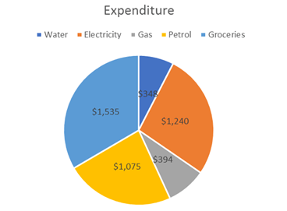
Module No. 2
Visualization Tools
Pie Charts
- It is a circular graph divided into slices.
- is defined as a circular chart with multiple divisions where each division shows the contribution of each value to the total value.
- all data points are positive
When to use a pie chart
So, pie charts are best suited to depict sections of a whole.
Example:
-Different Expenditures done from the given total amount.

Slide 36
Module No. 2
Advantages of Pie Chart
1. Easy to create: No need to worry about customization and formatting of your chart
2. Easy to read: can be read easily if you only have a few data points.
3. Management is obsessed with Pie Charts: managers/clients love to have Pie charts in the official presentation.
Disadvantages of Pie Charts
Pie Charts are useful with fewer data points and often becomes complex when adding more data points.
Pie Charts can't be used to show a trend as they are meant to present you the snap of the values at a certain point in time.
Pie Charts can't show multiple types of data values.
Pie Charts take more space and give less information.

Slide 37
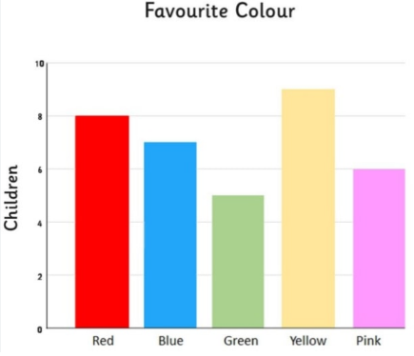
Module No. 2
Bar Diagrams
defined as a graph or chart that represents explicit data in the form of rectangular bars.
represents categorical data with rectangular bars with heights proportional to the values that they represent.
graph with rectangular bars, either horizontal or vertical.
It compares frequencies of other measures of distinct categories.
Here one axis of the chart plots categories and
the other axis represents the value scale.

Slide 38
Module No. 2
Advantages of Bar Graph
It is easy to understand.
It represents the Categorical data in pictorial form.
It makes the analysis of data easy.
We can easily compare data with other variables.
It does not require too much effort to plot it.
It is a widely used method of data representation.
It is used in various fields such as retail, business, sports, etc.
Types of Bar Charts
Pareto charts - These charts are arranged from highest to lowest incidence.
Column or Vertical Bar Charts - are excellent for mapping data sets over a period of time.
Stacked Bar Chart - represent different groups on top of each other.
Grouped Bar Chart -two or more bars which are color-coded to represent a particular grouping.

Slide 39
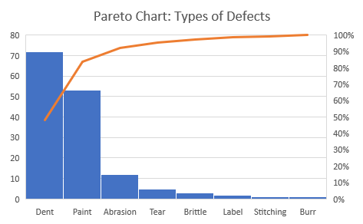
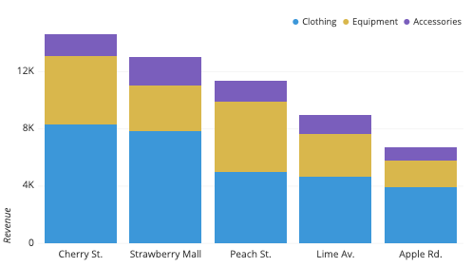
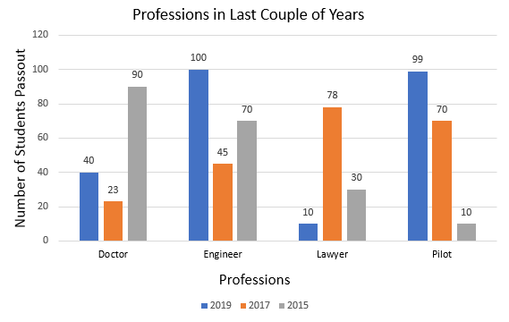
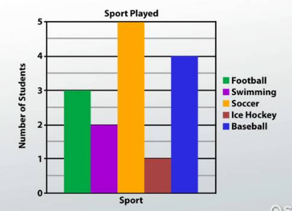
Module No. 2

Slide 40
Module No. 2
When to Use a Bar Chart
When you need to compare a large set of categorical values
When required to compare multiple categories or sub-categories simultaneously
When you need to visualize two data sets on a single chart
When you need to gather insights on deviations in data
When Not to Use a Bar Chart
When you need to represent and compare a continuous set of data
When you need to represent trends in time and other variables

Slide 41
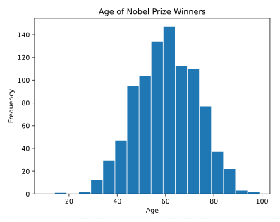
Module No. 2
Histograms
is a graphical representation of the distribution of a dataset.
show the probability distribution of a single continuous numerical variable.
histograms are two-dimensional plots with two axes
-> the vertical axis - frequency axis whereas
-> the horizontal axis - divided into a range of numeric values (intervals or bins) or time intervals
The frequency of each bin is shown by the area of vertical rectangular bars.
Each bar covers a range of continuous numeric values of the variable under study.

Slide 42
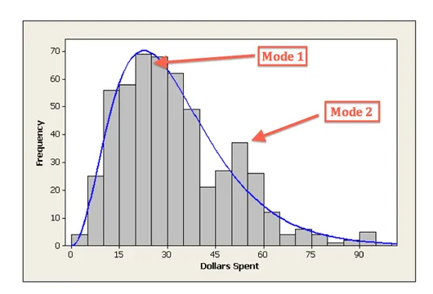
Module No. 2
Example:
24-hour convenience store collected data from 537 customers on the amount of money spent in a single visit to the store.
The overall shape of the distribution is skewed to the right with a clear mode around $25.
it has a second smaller peak around the $50–55 interval.
the majority of clients spend an average of $25 per purchase, there is a second minor group of clients spending around $50 per visit.

Slide 43
Module No. 2
Advantages of Histogram:
commonly used tool for charting continuous frequency distribution.
gives us some idea about the shape and spread of the data.
May be used for the graphic location of the value of Mode.
Disadvantages of Histogram:
may not be used for Categorical data representation
cannot be used to compare two different data sets.
the mean and the median cannot be calculated using a histogram.

Slide 44
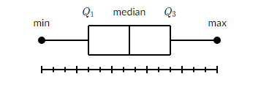
Module No. 2
Boxplot
- A box and whisker plot—also called a box plot displays the five-number summary of a set of data.
- that depicts a group of numerical data through their quartiles.
- simple way to visualize the shape of data.
- makes comparing characteristics of data between categories very easy.
The five-number summary is the
minimum,
first quartile,
median,
third quartile, and
maximum.

Slide 45
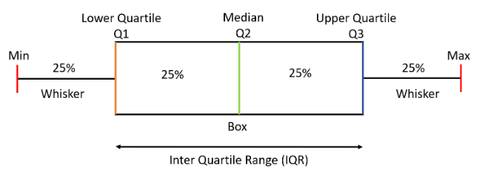
Module No. 2
A box plot gives a five-number summary of a set of data which is-
Minimum – It is the minimum value in the dataset excluding the outliers
First Quartile (Q1) – 25% of the data lies below the First (lower) Quartile.
Median (Q2) – It is the mid-point of the dataset. Half of the values lie below it and half above.
Third Quartile (Q3) – 75% of the data lies below the Third (Upper) Quartile.
Maximum – It is the maximum value in the dataset excluding the outliers.

Slide 46
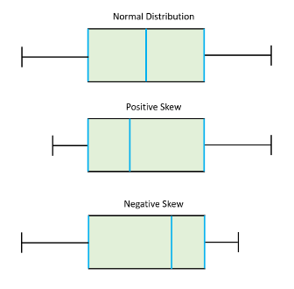
Module No. 2
IQR - area inside the box which has 50% of the data or midspread
The IQR is calculated as : IQR = Q3 - Q1
Outliers are the data points below and above the lower and upper limit.
Lower Limit = Q1 - 1.5*IQR
Upper Limit = Q3 + 1.5*IQR
Q1 = first quartile values and find their median.
Q3 = take remaining values and find their median.
Q2 = Median of the entire values
a) Normal Distribution - the Median is at the center of the Box and the whiskers are almost the same on both the ends
b) Positive Skew - the Median lies closer to the First Quartile and the whisker at the lower end is shorter (Right Skew).
c) Negative Skew - the Median lies closer to the Third Quartile and the whisker at the upper end is shorter (Left Skew).

Slide 47
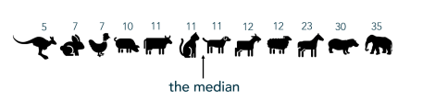
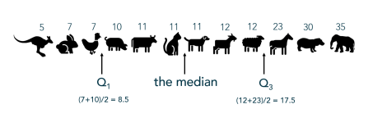
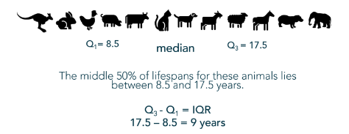
Module No. 2
Example: Lifespan of animals
Finding Median:
Identify Quartiles: Placing Q1 and Q3
Computing IQR:
Notes:
https://thestatsninja.com/tag/boxplot/

Slide 48
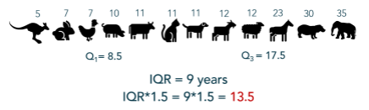
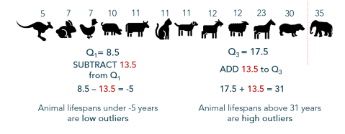
Module No. 2
Multiply the IQR by 1.5
Determine a threshold for outliers – the “fences”
1.5*IQR is then
- subtracted from the lower quartile and
- added to the upper quartile
to determine a boundary or “fences” between non-outliers and outliers.
Consider values beyond the fences outliers

Slide 49
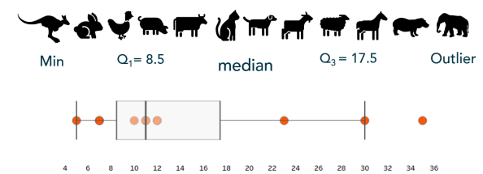
Module No. 2
Build the boxplot

Slide 50
Module No. 2
Advantages of Box Plot:
Visual summary - Box plots provide a quick visual summary of the variability of values in a dataset
2. Data distribution - Box plots provide an instant visual representation of the data distribution.
3. Outliers - Box plots show the median, upper and lower quartiles, minimum and maximum values, and any outliers in the dataset.
4. Comparisons - Box plots are particularly useful for assessing quickly the location, dispersion, and symmetry or skewness of a set of data, and for making comparisons of these features in two or more data sets.
Disadvantages:
1. Hides distribution features
2. Box plots can be confusing for some audiences.
3. Box plots don't clearly show the original data.
4. Box plots can't identify the mean and mode.
5. Box plots hide gaps in distributions.

Slide 51
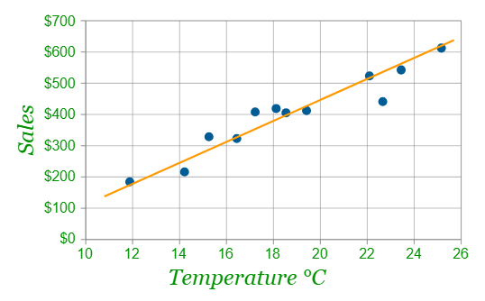
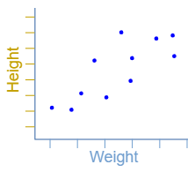
Module No. 2
Scatterplots
A scatter plot or scatter graph uses dots to represent values for two different numeric variables.
Scatter plots are used to observe relationships between variables.
We can also draw a "Line of Best Fit" ("Trend Line") on our scatter plot
Horizontal Axis – Independent Variable, Vertical Axis – Dependent Variable
Ice Creams Sales vs Temperature
Height vs Weight

Slide 52
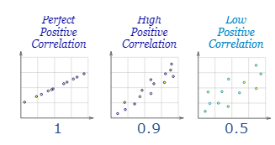
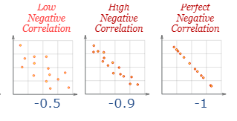
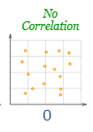
Module No. 2
Correlation in Scatter plots
High Correlation - When the two sets of data are strongly linked together
Positive Correlation - when the values increase together, and
Negative Correlation - when one value decreases as the other increases

Slide 53
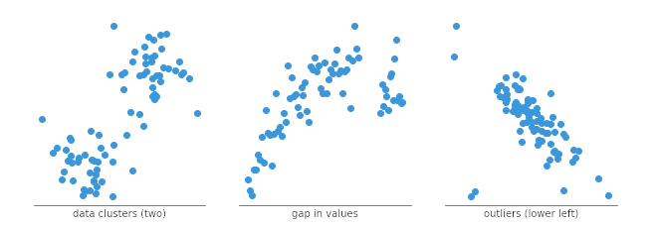
Module No. 2
We can divide data points into groups based on how closely sets of points cluster together.
Scatter plots can also show if there are any unexpected gaps in the data and
if there are any outlier points.

Slide 54
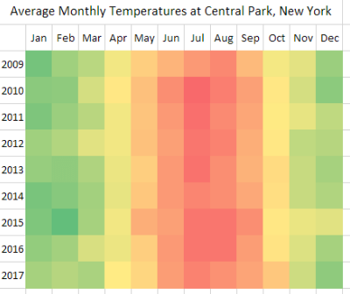
Module No. 2
Heat-maps
Heat Maps are graphical representations of data that utilize color-coded systems.
two-dimensional representation of information with the help of colors.
can help the user visualize simple or complex information.
Are capable of displaying complex data in a simple visual format for the end user.
Examples: Defense, Marketing and Understanding Consumer Behavior, Election Results and etc.

Slide 55
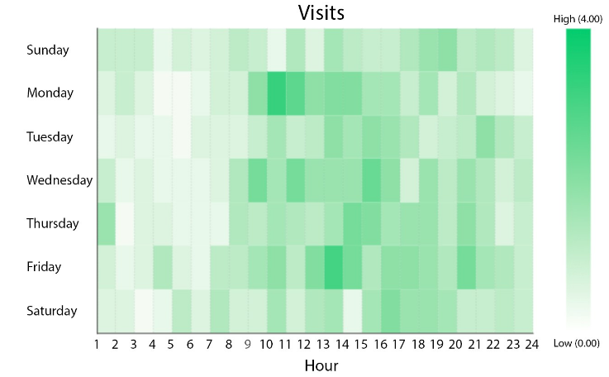
Module No. 2
Example : The busy hours of the Departmental Store on different days in a week

Slide 56
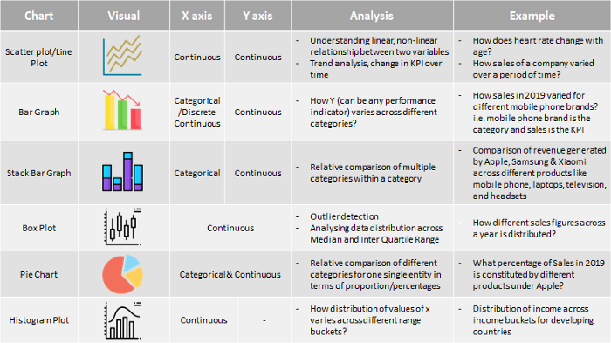
Module No. 2

Slide 57
Module No. 2
Summary:
Analytics and Types of Analytics
Statistics and Descriptive Statistics
Mean and Standard Deviation
Skewness and Kurtosis
Role of Data Visualization in understanding data and find errors
Types of Dataset
Different types of Variables
Types of Analysis based on no. of variables participation
Visualization Tools

